Slide 1
Raspberry Pi
Week 7

Slide 2
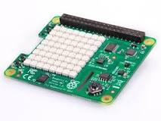
What sensors are on the Sense HAT?
The Sense HAT has an 8×8 RGB LED matrix, a five-button joystick and includes the following sensors:
Gyroscope.
Accelerometer.
Magnetometer.
Temperature.
Barometric pressure.
Humidity.

Slide 3
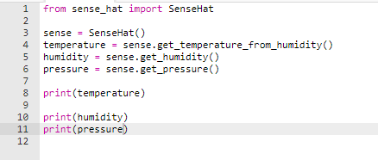

Read from R-pi

Slide 4
Detecting movement
The Sense HAT has an IMU (Inertial Measurement Unit) chip which includes a set of sensors that detect movement:
A gyroscope (for detecting which way up the board is)
An accelerometer (for detecting movement)
A magnetometer (for detecting magnetic fields)

Slide 5
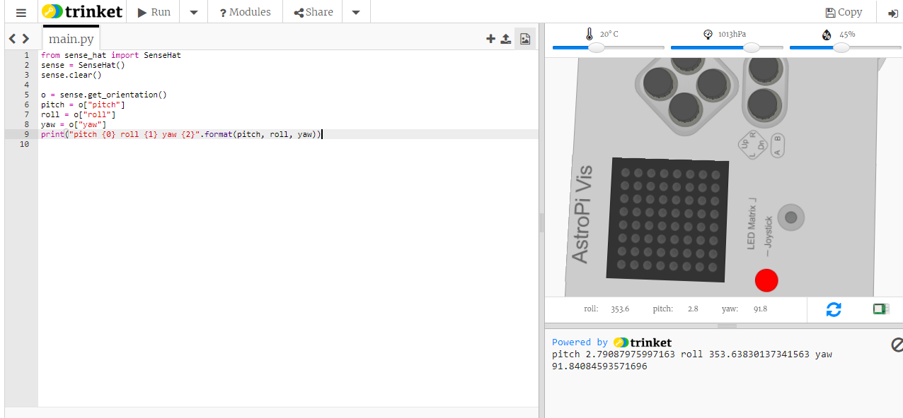
Learn about pitch, roll, and yaw
The Sense HAT has orientation sensors which detect pitch, roll, and yaw. Do the following to access these data.

Slide 6
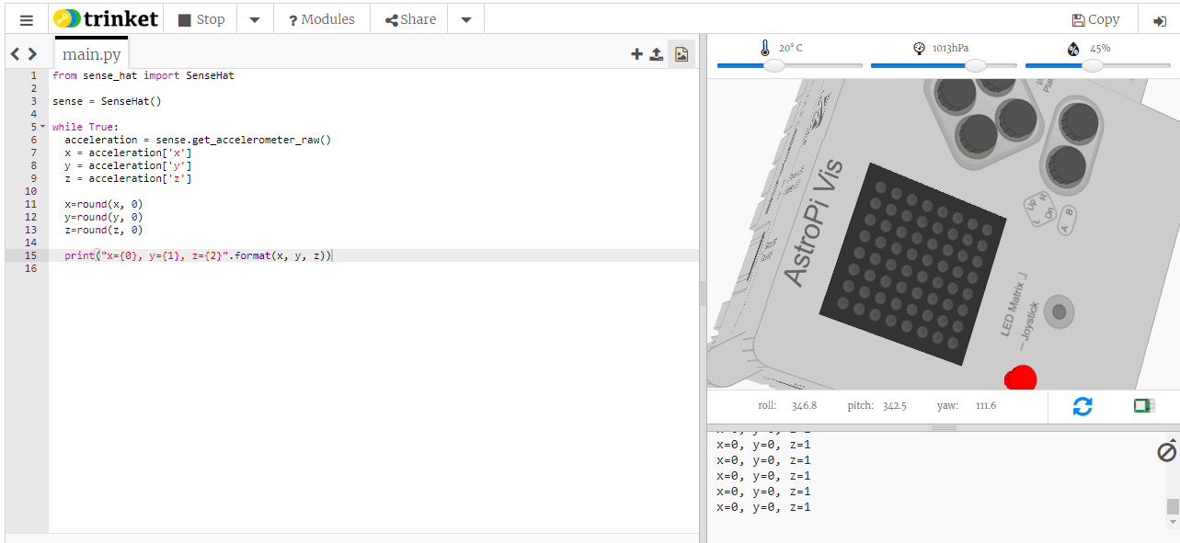
Refer for more functions: https://pythonhosted.org/sense-hat/api/
The sense.get_accelerometer_raw() method - Gets the raw x, y and z axis accelerometer data.
It tells you the amount of G-force acting on each axis (x, y, z). If any axis has ±1G, then you know that axis is pointing downwards.
In this example, the amount of gravitational acceleration for each axis is extracted and is then rounded to the nearest whole number:

